Slide 1
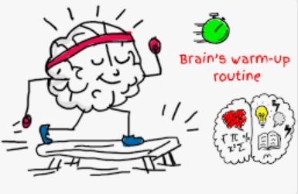



Slide 2
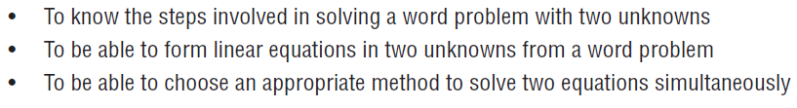
Learning intentions – Ex 1K
APPLICATIONS of SIMULTANEOUS EQUATIONS

Slide 3
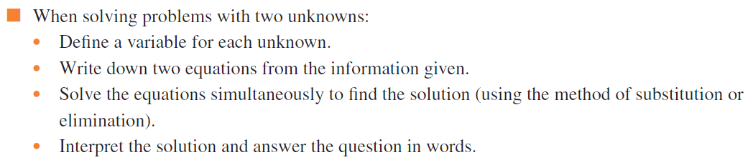
Key Ideas
WARM UP​ | NEW LEARNING​ | DIVE IN​ | REFLECT​

Slide 4
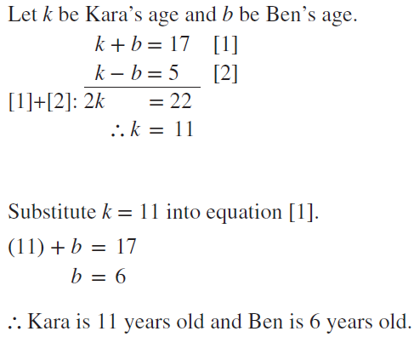
Example
Setting up and solving simultaneous equations
WARM UP​ | NEW LEARNING​ | DIVE IN​ | REFLECT​

Slide 5


Example
Setting up and solving simultaneous equations
WARM UP​ | NEW LEARNING​ | DIVE IN​ | REFLECT​
Answer:

Slide 6
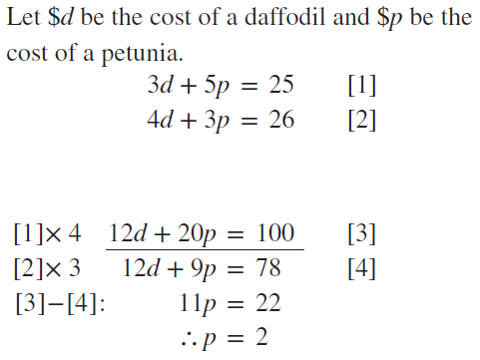
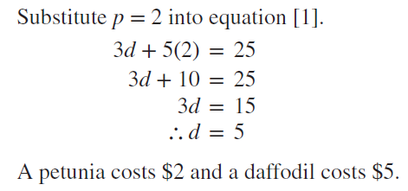
Example
Solving further applications of simultaneous equations involving two variables
WARM UP​ | NEW LEARNING​ | DIVE IN​ | REFLECT​

Slide 7


Example
Solving further applications of simultaneous equations involving two variables
WARM UP​ | NEW LEARNING​ | DIVE IN​ | REFLECT​
Answer:

Slide 8
Learning intentions (recap)
WARM UP​ | NEW LEARNING​ | DIVE IN​ | REFLECT​
Working programs | Exercise 1K
 | Foundation | Standard | Advanced
Fluency 1–5 |  | 4,5
Problem-solving 6–9 |  | 6.8.9
Reasoning 10–12 |  | 10
Enrichment 13–14 | — | — | 13–14

